Slide 1

Basic Details of the Team and Problem Statement
Organization Name: Coal India Limited
PS Code: NC740
Problem Statement Title: Moving vehicle registration plate detection
Team Name: Pyramid Scheme
Team Leader Name: S.Surya
Institute Code (AISHE): U—0489
Institute Name: Vel Tech Rangarajan Dr. Sagunthala R&D Institute of Science and Technology
Theme Name:

Slide 2
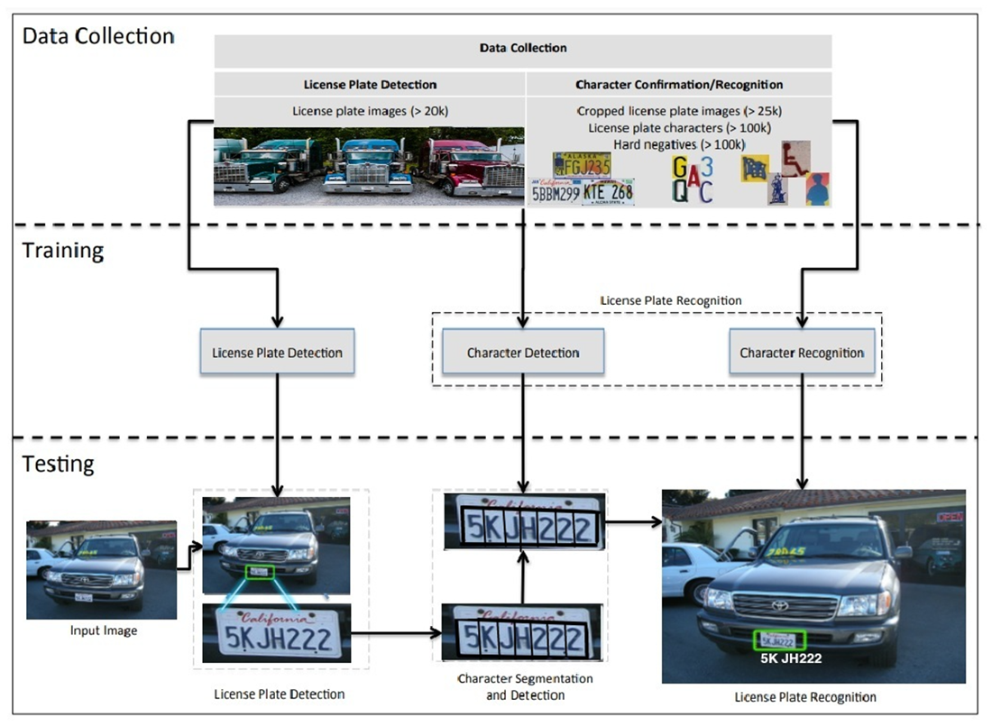
Idea/Approach Details
Describe your idea/Solution/Prototype here:
Describe your Technology stack here:

Slide 3
Idea/Approach Details
Describe your Use Cases here
Describe your Dependencies / Show stopper here

Slide 4
Team Member Details
Team Leader Name: S.Surya
Branch : B. Tech Stream : IT Year : III
Team Member 1 Name: P.Tamilarasan
Branch : B. Tech Stream : IT Year : III
Team Member 2 Name: M.Jayarraman
Branch : B. Tech Stream : IT Year : III
Team Member 3 Name: S.Pavithran
Branch : B. Tech Stream : IT Year : III
Team Member 4 Name: P.S.KarthikSrinath
Branch : B. Tech Stream : IT Year : III
Team Member 5 Name: R.M.Ramya
Branch : B. Tech Stream : IT Year : III
Team Mentor 1 Name: Sakunthala Prabha K.S.
Category : Academic Expertise : AI and Deep Learning Domain Experience : 14
Team Mentor 2 Name: Lijetha C Jaffrin
Category : Academic Expertise : AI and Deep Learning Domain Experience : 12

Slide 5
Important Pointers
Please ensure below pointers are met while
Kindly keep the maximum slides limit to 4 pages
All the topics should be utilized for description of your idea
Try to avoid paragraphs and post your idea in points
Keep your explanation precisely and easy to understand
Idea should be unique and novel. If it has a business potential more weightage will be given.
Apart from this PPT abstract of your idea will be asked separately while submitting
You need to save the file in PDF and upload the same on portal. No PPT, Word Doc or any other format will be supported
You can delete this slide (Important Pointers) when you upload the details of your idea on SIH portal.

